Slide 1

WIFI BASED WEB CONTROLLED SURVEILLANCE BOT
TEAM MEMBERS : SAI MAHESH
SAI KRISHNA

Slide 2
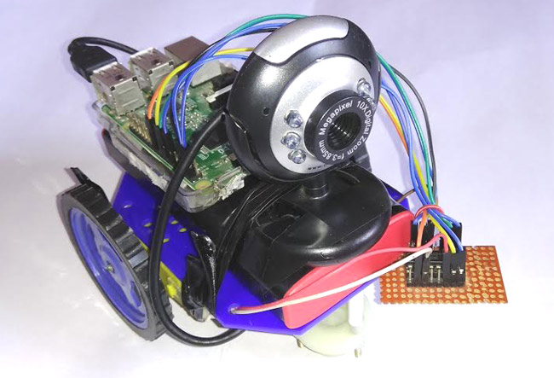
CHECK THIS : 192.168.43.116:5010

Slide 3
USES OF WI-FI CONTROLLED BOT OVER BLUETOOTH CONTROLLED BOT
THE BOT CAN BE OPERATED FROM VARIOUS DEVICES SIMULTANEOUSLY.
CAN BE OPERATED FROM A LARGE DISTANCE.
NO APPS INSTALLATION REQUIRED FOR CONTROLLING.
GOOD QUALITY OF VIDEO STREAMING.
SURVEILLANCE CAN BE DONE FROM DIFFERENT DEVICES SIMULTANEOUSLY.

Slide 4
THANK YOU

